Slide 2
Preactor Training
The Application Programming Interface

Slide 3
Agenda
Part 1
Introduction to the SDK
Overview of Objects
Custom Actions
Definition & Calling
Workshop
Using the Preactor Object
Data Manipulation
Debugging
Workshops
Part 2
Introduction to the Planning Board Object
Creating a Custom Scheduling Rule
Event Based
Algorithmic Based
Custom Windows
Workshop
Further Information

Slide 4
Introduction to the SDK
The Preactor SDK includes content for the Preactor API, including project & item templates.
Template Projects
As there is some code required to a get a tool to work within Preactor, these templates have been provided to reduce the over head of writing this when creating new projects
Both VB.NET and C Sharp templates are provided for Microsoft’s Visual Studio.

Slide 5
Overview Of The Objects
Preactor exposes two objects to the programmer:
IPreactor
IPlanningboard
The Interface that describes the methods and properties available for Preactor
The database object used for data manipulation I/O etc.
The Interface that describes the methods and properties available for the Planning Board
Represents the electronic planning board referenced in custom scheduling rules.

Slide 6
Overview Of The Objects
Characteristics Of The Objects Interface methods:
Return Values
Object methods return their results as return values.
Exceptions
Raised to detect whether a method call failed
Null
When an item cannot be found a NULL object is returned

Slide 7
Overview Of The Objects
Characteristics Of The Objects Interface methods:
Enumerable Methods
The results of a method call may be an enumerator.
Structures
Return a group of values as a single object
FormatFieldPair
Represents a field in a table
PrimaryKey
Can be used in place of a record number

Slide 8
Overview Of The Objects
Characteristics Of The Objects Interface methods:
Examples of IPreactor methods
ReadField()
Returns the content of a single field in a table
WriteField()
Writes a value to a field in a table

Slide 9
Overview Of The Objects
Characteristics Of The Objects Interface methods:
Examples of IPlanningBoard methods
TestOpOnResource()
Returns the earliest possible time an operation could be processed on a resource (like ‘drag’)
PutOpOnResource()
Schedule an operation into a resource at a specified time (like ‘Drop’)
IsResourceFree()
Returns TRUE or FALSE if a resource is available at a specific time

Slide 10
Overview Of The Objects
Availability By Version:
Preactor Licence | IPreactor | IPlanningBoard | Comment
Express | No | No
200 FCS | Yes | No
300 FCS | Yes | Partial | Read Only
400 APS (SMC) | Yes | Yes
500 APS (AMC) | Yes | Yes

Slide 11
Creating Custom Actions
Here is a summary of the main steps required to call custom code from within a Preactor configuration.
In Visual Studio create:
A Preactor Project containing a Custom Action class. (using the templates provided)
Compile the project
In a Preactor configuration define:
A custom action in the Custom Actions Table
An Event Script to execute the new custom action
Any additional menu buttons to execute the event script

Slide 12
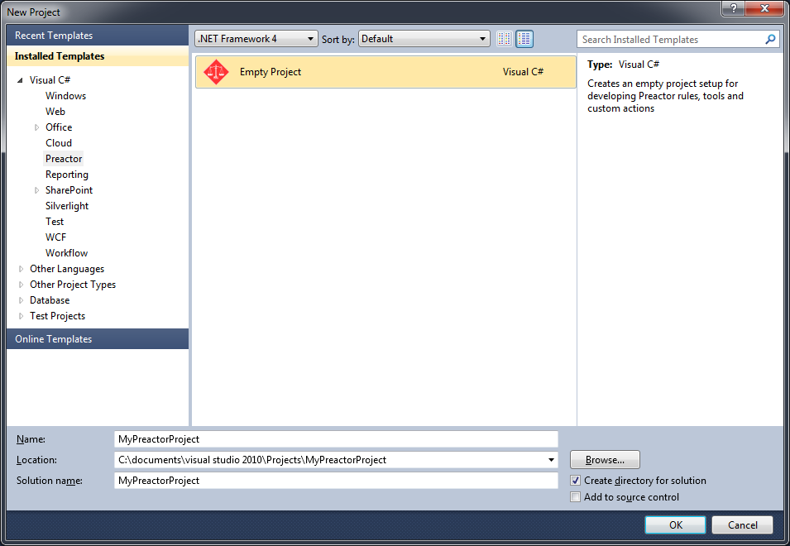
Creating Custom Actions
1. In Visual Studio create a Preactor Project using the project template:

Slide 13
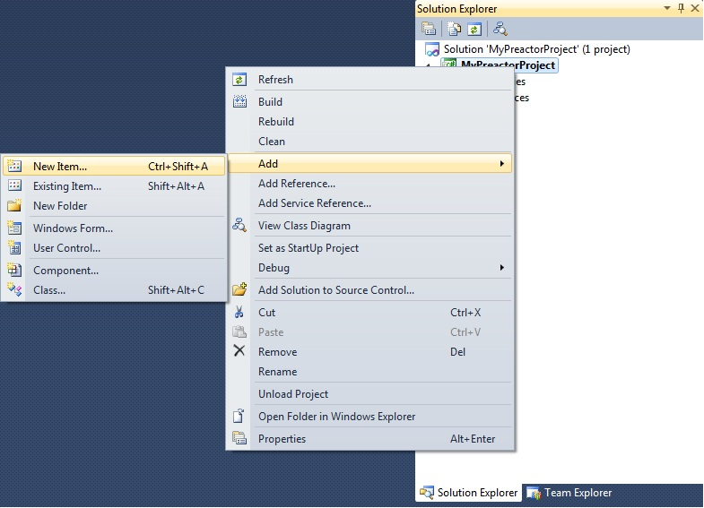
Creating Custom Actions
Add a Custom Action class item into the project, using the template provided:

Slide 14
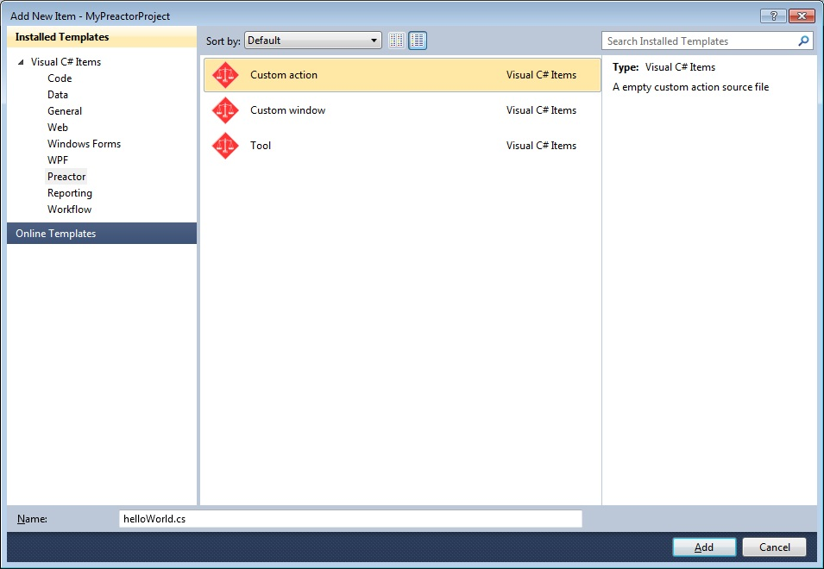
Creating Custom Actions
Add a Custom Action item into the project, using the template provided:

Slide 15
Creating Custom Actions
C#
using System;
using System.Runtime.InteropServices;
using Preactor;
using Preactor.Interop.PreactorObject;
using System.Windows.Forms;
namespace MyPreactorProject
{
[Guid("40ce6598-0a16-XXXX-XXXX-a0e33897cce3")]
[ComVisible(true)]
public interface IHelloWorld
{
int Run(ref PreactorObj preactorComObject, ref object pespComObject);
}
[ComVisible(true)]
[ClassInterface(ClassInterfaceType.None)]
[Guid("d3ebe4cc-XXXX-XXXX-adc6-0b3e8279d958")]
public class HelloWorld : IHelloWorld
{
public int Run(ref PreactorObj preactorComObject, ref object pespComObject)
{
IPreactor preactor = PreactorFactory.CreatePreactorObject(preactorComObject);
// TODO : Your code here
return 0;
}
}
}

Slide 16
Creating Custom Actions
VB
Option Strict On
Option Explicit On
Imports Preactor.Interop.PreactorObject
Imports Preactor
Imports System.Windows.Forms
<Microsoft.VisualBasic.ComClass("d0c8d078-844a-XXXX-XXXX-b823c2e3d31e", "f984a747-XXXX-XXXX-a269-94253dcbdaef")> _
Public Class HelloWorld
Public Function Run(ByRef preactorComObject As PreactorObj, ByRef pespComObject As Object) As Integer
Dim preactor As IPreactor = PreactorFactory.CreatePreactorObject(preactorComObject)
'TODO : Your code goes here
Return 0
End Function
End Class

Slide 17
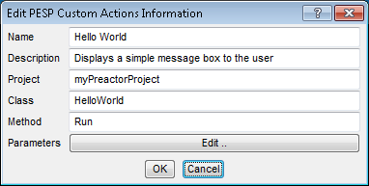
Creating Custom Actions
Define a Custom Action item in the Preactor configuration.
Use the Project, Class & Method as defined in the Visual Studio project (text should be an exact match).

Slide 18
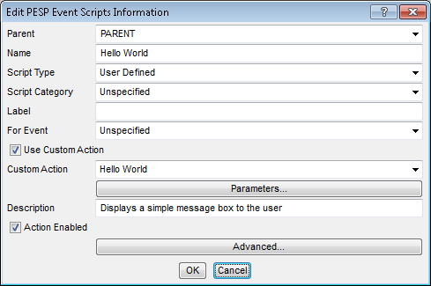
Creating Custom Actions
Add a Event Script into the configuration, that executes the custom action:

Slide 19
Creating Custom Actions
Now a Custom Action & Event Script is defined, here’s how to call it from different places.
This can be done in a number of ways:
From the Sequencer window Tools menu
Edit the preactor.prMdf file (Menu Definition File)
From the Sequencer right-click menu
Edit the Advanced Options of the Event Script
From the Workspace menu
Edit the preactor.prMdf file (Menu Definition File)

Slide 20
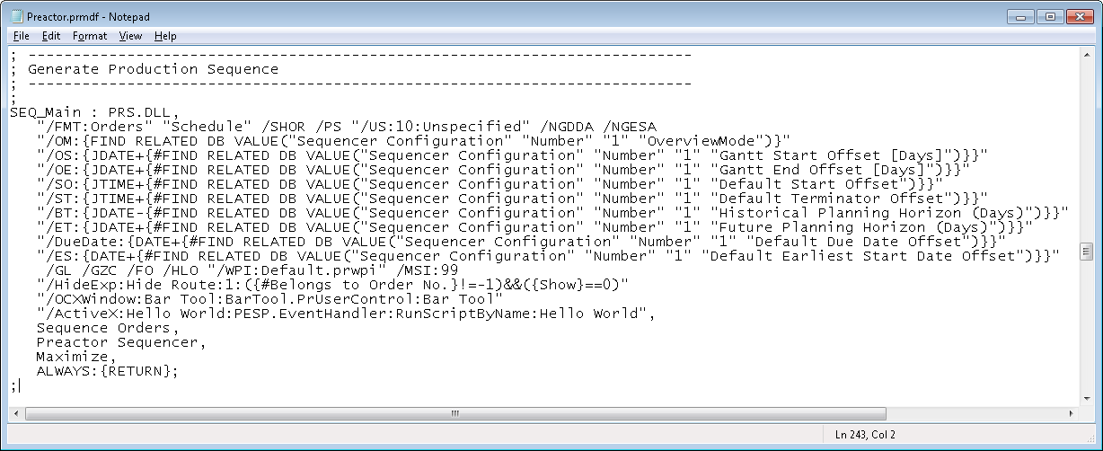
Creating Custom Actions
1. From the Sequencer Tools menu:

Slide 21
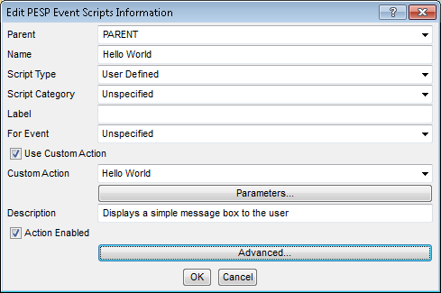
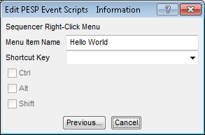
Creating Custom Actions
2. From the Sequencer right-click menu:

Slide 22
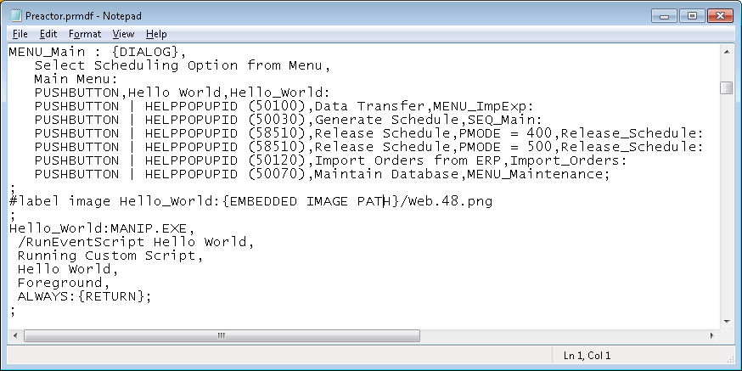
Creating Custom Actions
3. From the Workspace menu button:

Slide 23

Workshop #1
Display a Hello World Message Box in Preactor

Slide 24
Workshop #1
Display a simple Hello World message box from three different places in the configuration provided.
From the Sequencer window Tools menu
From the Sequencer right-click menu
From a Workspace menu option (Shell menu)

Slide 25
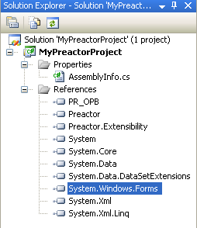
Workshop #1 – Help
Extract the package in the location:
Desktop\Training Files\API Course\APSTrainingConfig
To display a message box in .NET add a reference to System.Windows.Forms to your project
C# syntax
Using System.Windows.Forms;
VB syntax
Imports System.Windows,Forms

Slide 26
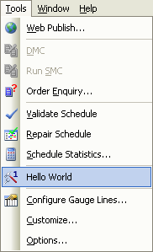
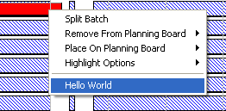
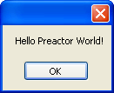

Workshop #1 Results
Display a simple Hello World message box from three different places:
All these calls run the ‘Hello World’ Event Script/Custom Action.
This is a good way to start a new project and establish a connection to Preactor

Slide 27
Using The IPreactor Object
Data Manipulation has the following sections:
Reading / Writing data
Creating records
Locating records
Using Primary Keys to remote tables

Slide 28
Using The IPreactor Object
Data Manipulation – Reading Data
Specific ReadField method overloads are present for each of the following data types:
Method Overload | Preactor Field Type
ReadFieldBool | TOGGLE
ReadFieldDateTime | TIME
ReadFieldInt | INTEGER
ReadFieldDouble | REAL and DURATION
ReadFieldString | STRING
If unsure of a field’s data type, check the field’s definition in the Preactor .prTdf file

Slide 29
Using The IPreactor Object
Data Manipulation – Reading Data
There are two types of data storage:
Flat Data
Top level data that’s displayed when you edit (double click) a single record in a table.
Matrix Data
Where there may be many items associate with a single record
E.g. multiple resource can be associated with a single resource group.

Slide 30
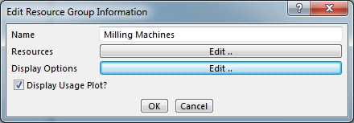
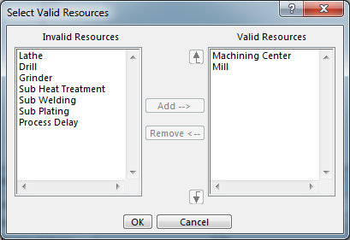
Using The IPreactor Object
Data Manipulation – Reading Data
Flat Data:
Matrix Data:

Slide 31
Using The IPreactor Object
Data Manipulation – Reading Data
Matrix Data
Identified by AUTO LIST or AUTO DIMENSION classifications
AUTO DIMENSION - numeric Data only
1 or 2 dimensional arrays
ReadField method has overloads to read matrix data
Additional x & y axis parameters

Slide 32
Using The IPreactor Object
Data Manipulation – Reading Data
The MatrixFieldSize() method can be used to determine the upper limit for any code attempting to read from a matrix type field.
ASSOCIATE matrix fields will have their dimensions set by the size of the AUTO LIST field they are linked to.

Slide 33
Using The IPreactor Object
Data Manipulation – Reading Data
The following slide shows example code that retrieves the size of a matrix field, and populates a data dictionary with the contents

Slide 34
Using The IPreactor Object
C#
Data Manipulation – Reading Data
var matrixSize = preactor.MatrixFieldSize("Orders", "Pegged Items", recNo);
var values = new Dictionary<double, double>();
for (int i = 1; i <= matrixSize.X; i++)
{
//Read Preactor Data fields
var key = preactor.ReadFieldDouble("Orders", "Pegging Key", recNo, i);
var qty = preactor.ReadFieldDouble("Orders", "Pegging Qty", recNo, i);
//Add Data to dictionary object
values.Add(key, qty);
}
//Now use the values in the dictionary to get values by primary key

Slide 35
Using The IPreactor Object
VB
Data Manipulation – Reading Data
Dim size = preactor.MatrixFieldSize("Orders", "Pegging Key", recNo)
Dim values = New Dictionary(Of Double, Double)()
For i As Integer = 1 To size.X
Dim key = preactor.ReadFieldDouble("Orders", "Pegging Key", recNo, i)
Dim qty = preactor.ReadFieldDouble("Orders", "Pegging Qty", recNo, i)
values.Add(key, qty)
Next
//Now use the values in the dictionary to get values by primary key

Slide 36
Using The IPreactor Object
Data Manipulation – Reading Data
Primary Keys are the values used to uniquely link to records in other data tables
Removes the need for searching through the remote table to find a related record.
Done by creating a new PrimaryKey object

Slide 37
Using The IPreactor Object
Data Manipulation – Reading Data
How to use a PrimaryKey object from a database reference field:
Read the db reference field using the ReadFieldDouble method
Create a new PrimaryKey object with the double value
Use the PrimaryKey object in place of the record number parameter in all ReadField Methods

Slide 38
Using The IPreactor Object
C#
Data Manipulation – Reading Data
// Read resource key
var keyValue = preactor.ReadFieldDouble("Orders", "Resource", recNo);
// Create a primary key object
var resPrimaryKey = new PrimaryKey(keyValue);
// Now read information about this resource from resources table
var resEfficiency = preactor.ReadFieldDouble("Resources","Efficiency %", resPrimaryKey);

Slide 39
Using The IPreactor Object
VB
Data Manipulation – Reading Data
' Read resource key
Dim keyValue = preactor.ReadFieldDouble("Orders", "Resource", 1)
' Create a primary key object
Dim resourcePrimaryKey = New PrimaryKey(keyValue)
' Read information from resources table
Dim resourceEffciency = preactor.ReadFieldString("Resources", “Effciency %", resourcePrimaryKey)

Slide 40
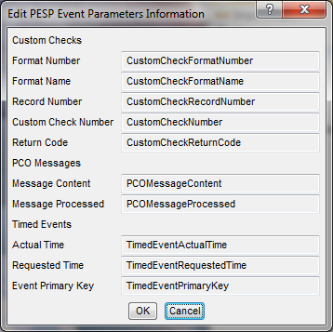
Using The IPreactor Object
Data Manipulation – Reading Data
Event Parameters
These are PESP variables that can be referenced as parameters in actions/custom actions:
Parameter names can be found via the PESP menu option Event Parameter Mappings:
You can copy/paste the variable name from here

Slide 41
Using The IPreactor Object
Data Manipulation – Reading Data
Event Parameters
At each (PESP) event the parameters are populated automatically.
They can tell you useful information about the last event such as the:
Record Number
Table Name/Number
Etc..

Slide 42
Workshop #2
Use an event parameter to read in field values and display them in message box.

Slide 43
Workshop #2
Pass the event parameter record number as a parameter into a custom action, and then read fields from this record
Modify Work Shop 1 code
Add a parameter to the custom action
Must be Integer
Give it a name e.g. recNo
In code, read the Part No. field into both
A string variable
A numeric variable
Output both values to a message box
Custom action to run on Right-Click only

Slide 44
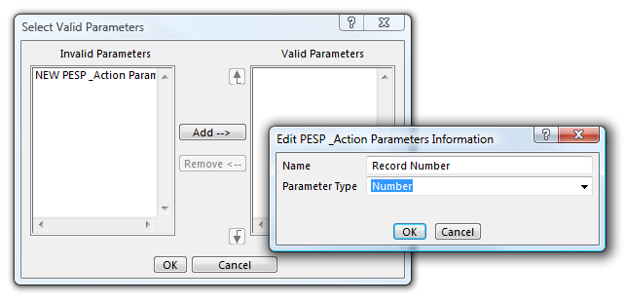
Workshop #2 – Help
Add the parameter to a custom action definition
Give it a Name & Type (Number)
You will now need to reselect the action in the PESP script to refresh the list of parameters

Slide 45
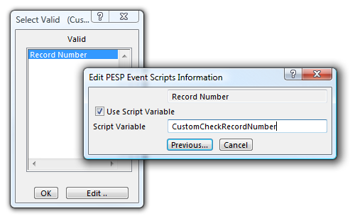
Workshop #2 – Help
You will now need to reselect the Custom Action in the PESP script in order to refresh the list of parameters and populate its value
Define the event variable name you want to pass in:

Slide 46
Workshop #2 – Help
The function header in code will need to be modified to accommodate the new parameter:
C#
public int Run(ref PreactorObj preactorComObject, ref object pespComObject, ref int recNo)
In C# the interface section will also need to modified.
VB
Public Function Run(ByRef preactorComObject As PreactorObj, ByRef pespComObject As Object, ByRef recNo As Integer) As Integer

Slide 47
Using The IPreactor Object
Data Manipulation – Writing Data
Data is written using the WriteField method, it takes the following parameters:
Table Name
Field Name
Record Number
Value (to be written)
It is up to you to ensure that the value being written is the correct data type

Slide 48
Using The IPreactor Object
Data Manipulation – Writing Data
There are also two methods for writing into matrix fields, depending on the field type:
WriteListField
Used for AUTOLIST matrix (1d)
WriteMatrixField
Used for AUTO DIMENSION fields (2d)

Slide 49
Using The IPreactor Object
Data Manipulation – Writing Data
Note that if you have changed any values in the fields which are referenced by any UPDATE REFERENCE classification on other fields, then you will need to call the UpdateRecord() method to refresh their values.

Slide 50
Using The IPreactor Object
Data Manipulation – Writing Data
The EditRecord() method can be used to display the dialog for any record, in any table
This can be useful for:
Taking parameters for a custom scheduling rule
Parameters for data management tools
Editing underlying tables whilst in the sequencer

Slide 51
Workshop #3
Read an operation’s Setup Time from the Products table, and then write it back to the orders record that was clicked on.

Slide 52
Workshop #3
Lookup operation’s Setup Time from the Products table, and then write it back to the orders record that was clicked on.
Build on Workshop 2 code
Retrieve the Setup Time from the products table, for the operation clicked on in the sequencer.
Write the string value back into the orders table (Notes field)
Add the Notes field to the tooltip display for easier viewing

Slide 53
Workshop #3 - Help
Read an operation’s Setup Time from the Products table, and then write it back to the orders table record that was clicked on.
Read the Part No. field as a number
Create a new PrimaryKey using this value
Use the primary key object (instead of the rec no.) to read the Setup Time field from the Products table
Write this value back to the orders table (into Notes field of the record clicked on)

Slide 54
Using The IPreactor Object
Data Manipulation – Creating Data
Use the .CreateRecord method to create a new record in any Preactor table
Parameters
Format Name
Insert Point (optional)
Example C#:
var newRecordNo = preactor.CreateRecord(“Orders”);

Slide 55
Using The IPreactor Object
Data Manipulation – Creating Data
Once you have created the new record, you have two choices for how to populated it with data
Individually populate each field using .WriteField() method
Use the .CopyRecord() method a similar record, and then update only the data that is different

Slide 56
Using The IPreactor Object
Data Manipulation – Creating Data
Adding items to an AUTOLIST field requires the use of two methods
.MatrixFieldSize – Retrieves the current array size
.SetAutoListSize – Resizes an AUTOLIST field
In order to add items to the start or middle of a AUTOLIST you must:
Create a list object in code to store the new correctly sorted auto list items in (see code sample in reading data section)
rewrite the entire matrix from the list object
If the AUTO LIST field has any ASSOCIATED fields they also need adding to the List object by making it List of Structures

Slide 57
Workshop #4
Create a new works order in Orders table for the same product that is right-clicked on. Then present the dialog to the user for manual editing.

Slide 58
Workshop #4
The user right clicks on an operation in the sequencer and runs a custom action.
The custom Action creates a new WO for the same product and presents the dialog to user to enter further details (order no. etc.).
.EditRecord will present the dialog to the user
Update the bar tool selection etc. by adding a final line to your PESP script
Call the ‘Update Bar Tool’ custom action

Slide 59
Using The IPreactor Object
Locating Data in Preactor using FindMatchingRecord method
The API supplies the method .FindMatchingRecord and parameters are:
Format Name
Field Name
Record No. – start point for the search
Is not inclusive of the record number passed
Value – the value to match on
Direction (optional)
Returns the Rec No. of the first matching record
By calling this within a While Loop, and use the return value as the starting point all matching records with a table can be found.

Slide 60
Using The IPreactor Object
Locating Data in Preactor using FindMatchingRecord method
C#
int matchRecord = 0;
matchRecord = preactor.FindMatchingRecord("Orders", "Part No.", matchRecord,-1);
while (matchRecord > 0)
{
//process record here
matchRecord = preactor.FindMatchingRecord("Orders", "Part No.", matchRecord,-1);
}

Slide 61
Using The IPreactor Object
Locating Data in Preactor using FindMatchingRecord method
VB
Dim matchRecord = 0
matchRecord = preactor.FindMatchingRecord("Orders", "Part No.", matchRecord,-1)
While matchRecord > 0
'process record here
matchRecord = preactor.FindMatchingRecord("Orders", "Part No.", matchRecord,-1)
End While

Slide 62
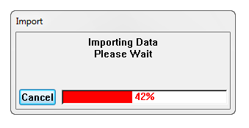
Using The IPreactor Object
Status Bars
The Preactor Object has methods that support Status Bar Control
.DisplayStatus (Title, Message)
.UpdateStatus (CurrentPos, MaxPos)
Cancel button press can be detected by return value constant
ProgressBarStatus.UserCancelled
.DestroyStatus()

Slide 63
Workshop #5
Create a new works order in Orders table for the same product that is right-clicked on with a predefined quantity.

Slide 64
Workshop #5
The user right clicks on an operation in the sequencer your function creates a new WO for that product and also calculates the new quantity (based on some rules - see below).
Build on workshop 4
Create a new WO record
Calculate the new quantity
Check total quantity for a product in current schedule
Then create a new order to make up the difference to the next economic batch size of 50

Slide 65
Workshop #5 - Help
Example of calculation to determine the new order’s quantity
BatchSizeMultiple = TotalQty / MinBatchSize(rounded up)
NewOrderQty = ((MinBatchQty * BatchSizeMultiple) – TotalQty
Create a variable to hold the Min. Batch Size.

Slide 66
Using The IPreactor Object
Debugging
To debug your code select ‘Start External Program’ as the Start Action on the Debug tab of your project properties.
This will start the Preactor configuration Selector
By setting the working directory and the Command line arguments a specific Preactor configuration can be run

Slide 67
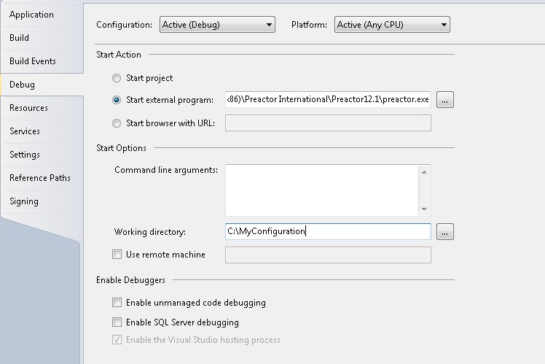
Using The IPreactor Object
Debugging

Slide 68
Course Agenda
Part 1
Introduction to the SDK
Overview of Objects
Custom Actions
Definition & Calling
Workshop
Using the Preactor Object
Data Manipulation
Workshops
Debugging
Part 2
Introduction to the Planning Board Object
Creating a Custom Scheduling Rule
Event Based
Algorithmic Based
Custom Windows
Workshop
Further Information

Slide 69
Using The IPlanningBoard Object
There are two main types of scheduling rules available in Preactor APS (P400)
Algorithmic scheduling
Forward/Backward/Bi-Directional
Event Based scheduling
Parallel Loading/Preferred Sequence
The Preactor API supports both these approaches

Slide 70
Algorithmic Scheduling Demo
TIME
1
2
3
4
5
6
7
8
9
10
11
10
10
MC 1
10
20
20
40
20
40
MC 2
30
30
30
MC 3
40
MC 4
Notes:
Algorithmic
Preferred Res. Alternate Res.
Operation 10: MC1 or MC2
Operation 20: MC2 -
Operation 30: MC3 -
Operation 40: MC2 or MC4
Sequential Forward Loading will load one job at a time (the sequence will depend on selecting the ‘by priority’, ‘by due date’ or ‘FIFO’ options) and place the all operations onto the planning board either forward (first operation, then second etc., until all operations are loaded), backward (last operation loaded to meet the due date then the last but one operation etc., until all operations are loaded), or bi-directionally (here a critical operation is selected then all operations before this one are loaded backward and all subsequent operations loaded forward).
In terms of time, the first job is loaded from its earliest start time (assuming resources are available) and then time moved forward for all subsequent operations. The next job is loaded after ‘returning’ the time back to the earliest start time for this job. This is repeated until all Orders are dealt with.
In the following examples, the blue order is the highest and red is the lowest priority.

Slide 71
Event Based Scheduling Demo
Event Time
1
2
3
4
5
6
7
8
9
10
11
10
10
MC 1
10
20
20
20
40
MC 2
30
30
30
MC 3
40
40
MC 4
Notes:
Event Based:
Preferred Res. Alternate Res.
Operation 10: MC1 or MC2
Operation 20: MC2 -
Operation 30: MC3 -
Operation 40: MC2 or MC4
Simulation Based Scheduling
Parallel Loading again moves forward in time but never back as in the previous example. As each event occurs (when a vertical line appears) Preactor takes actions if it can.
All resources and operations from different Orders are loaded in parallel.

Slide 72
Algorithmic vs Event Based Scheduling
1
2
3
4
5
6
7
8
9
10
11
Algorithmic:
10
10
MC 1
MC 2
10
20
20
40
20
40
MC 3
30
30
30
40
MC 4
Event Based:
10
10
MC 1
10
20
20
20
40
MC 2
30
30
30
MC 3
40
40
MC 4
Notes:
Algorithmic
Preferred Alternate
Operation 10 Resources: MC1 or MC2
Operation 20 Resources: MC2 -
Operation 30 Resources: MC3 -
Operation 40 Resources: MC2 or MC4

Slide 73
Algorithmic vs Event Based Scheduling
Algorithmic scheduling:
High priority order complete earlier
Compatible with multi-pass rules (PESP)
Uses advanced scheduling constraints (products table)
Event Based scheduling:
Overall schedule span shorter
More use of alt. resources
Explicit resource selection control through API

Slide 74
Calling a Custom Rule
How to call a custom APS rule from within the Preactor sequencer

Slide 75
Creating Custom Rules
Before we look at a custom schedule rule code in detail, let’s see how to set one up and call it from a Preactor configuration…

Slide 76
Creating Custom Rules
Calling Rules from the Sequencer
Use a Custom Action in a PESP script
Make sure the Script Type is set as “APS Rule”
This will mean the Rule will be selectable when the user chooses to sequence using “APS Rules”
Restart Preactor once the Custom action has been added

Slide 77
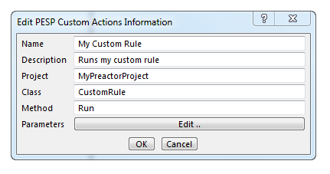
Creating Custom Rules
Custom Rule Action example:

Slide 78
Creating Custom Rules
Creating an Event Script to call a custom APS Rule.
Set the ‘Custom Action’ toggle to True
Set the Script Type as ‘APS Rule’
Select your APS from the list of Custom Actions

Slide 79
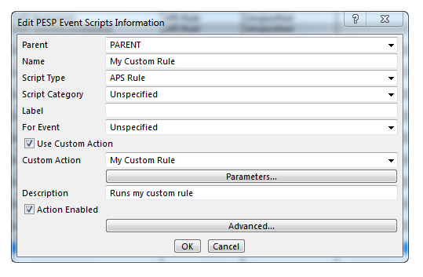

Calling Rules from the Sequencer
Select APS Rules in The Sequencer:
Now ‘My Custom Rule’ appears as a selection

Slide 80
Calling Rules from the Sequencer
A custom scheduling rule should only be called this way (i.e. APS type PESP script)
A custom scheduling rule should only be called this way
Using any other method (e.g. from a Tool button/right click option etc.), then the planning board object may not be initialized automatically.

Slide 81

Workshop 6 Calling A Custom Scheduling Rule

Slide 82
Workshop #6
Add a written custom schedule rule into your VB/C# solution, and call it from the example configuration.
Add the following 2 x template items into your solution:
Simple Algorithmic
Preactor Extensions
Add a new custom action
Create an ‘APS Rule’ type PESP script
Restart Preactor and test the new APS rule runs.

Slide 83
Event Based Scheduling APS Rules

Slide 84
Event Based Scheduling APS Rules
In Event Based Scheduling:
Time only moves foreword.
The schedule is build in parallel, for all resource, at the same time.
There is an APS rule call Parallel loading.
Events occur when the system status changes…
Time between events does not exist

Slide 85
Event Based Scheduling APS Rules
Event Processing – Events will occur when:
A resource has finished an operation
A resource shift state change has occurred
The contents of a queue have changed
A user event

Slide 86
Event Based Scheduling APS Rules
Event Processing
Specific modules of code can be written for each event type that can occur
Gives greater control as code is specific to event
Recommended - most event based rules are written this way.

Slide 87
Event Based Scheduling APS Rules
Event Processing - Flow Chart
Get Next Event
Detect Event Type
Operation Finished
Queue Change Event
Shift Change Event
Check All Resources
Check All Resources for the Queue that has changed
Check the Resource whose Shift has changed

Slide 88
Event Based Scheduling APS Rules
The Queue construct
Contain a list of operation that are eligible to start (record numbers).
Usually an individual queue for each primary resource.
Preactor will automatically add/remove items from queues, as events take place.
Ranking (sorting) the queues implements dispatching rule.

Slide 89
Event Based Scheduling Example Animation

Slide 90
Event Based Scheduling Demo
Event Time
1
2
3
4
5
6
7
8
9
10
11
10
10
MC 1
10
20
20
20
40
MC 2
30
30
30
MC 3
40
40
MC 4
Notes:
Event Based:
Preferred Res. Alternate Res.
Operation 10: MC1 or MC2
Operation 20: MC2 -
Operation 30: MC3 -
Operation 40: MC2 or MC4
Simulation Based Scheduling
Parallel Loading again moves forward in time but never back as in the previous example. As each event occurs (when a vertical line appears) Preactor takes actions if it can.
All resources and operations from different Orders are loaded in parallel.

Slide 91
Event Based Scheduling APS Rules
Event Processing - Flow Chart
1.
Get Next Event
2.
For Each Resource
No
3.
Is the resource free?
No
4.
Is there an operation in this queue ?
5.
No
Can the operation start now?
6.
Put (schedule) it on the resource
Is there another Resource?
No
Yes

Slide 92
Event Based Scheduling APS Rules
Event Processing - Flow Chart
Getting The Next Event on the Planning Board:
Var EventParameters=planningBoard.NextEvent();
while (EventParameters.HasValue)
{
//Code for Scheduling Logic Goes Here
EventParameters=planningBoard.NextEvent();
}

Slide 93
Event Based Scheduling APS Rules
Event Processing - Flow Chart
Set Up A Loop for Each Resource:
for (int ResRec = 1; ResRec <= preactor.RecordCount("Resources"); ResRec++)
{
//Code to deal with each resource affected by this //Event Type goes here
}
Is Resource Free At Event Time:
bool ResFree=planningBoard.IsResourceFree(ResRec,TestEventTime);

Slide 94
Event Based Scheduling APS Rules
Event Processing - Flow Chart
Getting Resource’s Queue Name:
var QName = PlanningBoard.GetResourceQueueName(ResRec);
// Check the Queue For Eligible Jobs:
int OpRecord=0;
int CurrentRank = 1;
while (planningBoard.GetOperationInQueue(QName, CurrentRank,
Ref OpRecord)&&ResourceFree)
{
//Code for schedule each job goes here
}

Slide 95
Event Based Scheduling APS Rules
Event Processing - Flow Chart
Check The Op. Can Start Now:
var TestOpResults = planningBoard.TestOperationOnResource(OpRecord, ResRec,
EventParameters.Value.EventTime);
if (!TestOpResults.HasValue)
{
CurrentRank++;
continue;
}
If (TestOpResults.Value.ChangeStart <= TestEventTime) Then
Schedule the Op:
planningBoard.PutOperationOnResource(OpRecord, ResRec, TestOpResults.Value.ChangeStart);

Slide 96
Event Based Scheduling APS Rules
C#
Schedule Operation sub function
private int ScheduleOperations(IPreactor preactor, string QName, int ResRec,DateTime TestEventTime)
{
IPlanningBoard planningBoard = preactor.PlanningBoard;
int CurrentRank = 1;
int OpRecord=0;
bool ResourceFree = planningBoard.IsResourceFree(ResRec, TestEventTime.AddDays(planningBoard.SchedulingAccuracy));
while (planningBoard.GetOperationInQueue(QName, CurrentRank, ref OpRecord) && ResourceFree)
{
var TestOpResults = planningBoard.TestOperationOnResource(OpRecord, ResRec,
TestEventTime);
if (!TestOpResults.HasValue)
{
CurrentRank++;
continue;
}
if (TestOpResults.Value.ChangeStart <= TestEventTime.AddDays(planningBoard.SchedulingAccuracy))
{
planningBoard.PutOperationOnResource(OpRecord, ResRec, TestOpResults.Value.ChangeStart);
} // if the operation could start now
else
{
CurrentRank++; // increment the rank so that we test the next job in the queue
}
// is the resource still free at this time?
ResourceFree = planningBoard.IsResourceFree(ResRec,TestEventTime.AddDays(planningBoard.SchedulingAccuracy));
} // whilst there is another operation in the queue }
return 0;
} // End of ScheduleOperations

Slide 97
Event Based Scheduling APS Rules
VB
Schedule Operation sub function
OpRecord = 0
CurrentRank = 1
ResourceFree = planningboard.IsResourceFree(ResRec, _
TestEventTime.AddDays(planningboard.SchedulingAccuracy))
While (planningboard.GetOperationInQueue(QName, CurrentRank, OpRecord) And ResourceFree)
TestOpResults = planningboard.TestOperationOnResource(OpRecord, ResRec, _
TestEventTime)
If Not TestOpResults.HasValue Then
CurrentRank = CurrentRank + 1
Continue While
End If ' if the test Op didn't return a value
If (TestOpResults.Value.ChangeStart <= TestEventTime.AddDays(planningboard.SchedulingAccuracy)) Then
planningboard.PutOperationOnResource(OpRecord, ResRec, _
TestOpResults.Value.ChangeStart) ' if the operation could start now
Else
CurrentRank = CurrentRank + 1 ' increment the rank so that we test the next job in the queue
End If ' if the operation could start now
' is the resource still free at this time?
ResourceFree = planningboard.IsResourceFree(ResRec, _
TestEventTime.AddDays(planningboard.SchedulingAccuracy))
End While ' whilst there is another operation in the queue
Return 0
End Function

Slide 98
Event Based Scheduling C# Code Example

Slide 99
Event Based Scheduling APS Rules
C#
Event Processing 1
int ResRec;
string QName;
Preactor.EventDetails? EventParameters=planningBoard.NextEvent();
while (EventParameters.HasValue)
{
switch (EventParameters.Value.EventType)
{
case EventTypes.OperationFinished:
// Event Parameter 1 is the Operation record that finished
// Event Parameter 2 is the Resource record that became available
// check all resources for this event because secondary constraints may have changed
for (ResRec = 1; ResRec <= preactor.RecordCount("Resources"); ResRec++)
{
QName = planningBoard.GetResourceQueueName(ResRec);
ScheduleOperations(preactor, QName, ResRec, EventParameters.Value.EventTime);
} // for each Resource
break;

Slide 100
Event Based Scheduling APS Rules
C#
Event Processing 2
case EventTypes.QueueChange:
// Event Parameter 1 is the number of the queue that changed
// check all resources which use this queue
int ResIndex = 1;
QName =
planningBoard.GetQueueName(EventParameters.Value.Parameter1);
while (planningBoard.GetQueuesResource(QName, ResIndex, ref ResRec))
{
ScheduleOperations(preactor, QName, ResRec, EventParameters.Value.EventTime);
ResIndex++;
} // whilst there is another resource for this queue
break;

Slide 101
Event Based Scheduling APS Rules
C#
Event Processing 3
case EventTypes.ShiftChange:
// Event Parameter 2 is the Resource record that had a shift change
// check the resource that had the shift change
int QNumber = planningBoard.GetResourceQueue(EventParameters.Value.Parameter2);
QName = planningBoard.GetQueueName(QNumber);
ScheduleOperations(preactor, QName, EventParameters.Value.Parameter2,
EventParameters.Value.EventTime);
break;
case EventTypes.UserEvent:
break;
default:
break;
}
EventParameters=planningBoard.NextEvent();
} // whilst there is another event
return 0;
}

Slide 102
Event Based Scheduling VB Example

Slide 103
Event Based Scheduling APS Rules
VB
Event Processing 1
While EventParameters.HasValue
Select Case EventParameters.Value.EventType
Case EventTypes.OperationFinished
' Event Parameter 1 is the Operation record that finished
' Event Parameter 2 is the Resource record that became available
' check all resources for this event because secondary constraints may have
‘ changed
For ResRec = 1 To preactor.RecordCount("Resources")
QName = planningboard.GetResourceQueueName(ResRec)
ScheduleOperations(preactor, QName, ResRec,
EventParameters.Value.EventTime)
Next ResRec

Slide 104
Event Based Scheduling APS Rules
VB
Event Processing 1
Case EventTypes.QueueChange
' Event Parameter 1 is the number of the queue that changed
' check all resources which use this queue
ResIndex = 1
ResRec = 0
QName = planningboard.GetQueueName(EventParameters.Value.Parameter1)
While (planningboard.GetQueuesResource(QName, ResIndex, ResRec))
ScheduleOperations(preactor, QName, ResRec, EventParameters.Value.EventTime)
ResIndex = ResIndex + 1
End While ' whilst there is another resource for this queue

Slide 105
Event Based Scheduling APS Rules
VB
Event Processing 2
Case EventTypes.ShiftChange
' Event Parameter 2 is the Resource record that had a shift change
' check the resource that had the shift change
QNumber = planningboard.GetResourceQueue(EventParameters.Value.Parameter2)
QName = planningboard.GetQueueName(QNumber)
ScheduleOperations(preactor, QName, EventParameters.Value.Parameter2, _
EventParameters.Value.EventTime)
Case EventTypes.UserEvent
Case Else
End Select
EventParameters = planningboard.NextEvent()
End While ' whilst there is another event
Return 0
End Function

Slide 106
Event Based Scheduling Despatching Rules

Slide 107
Event Based Scheduling APS Rules
Ranking/Sorting queues implements dispatching logic, sometimes referred to as optimisation rules
Queue ranking supports ranking by
Common Rules
User attributes
Expressions

Slide 108
Event Based Scheduling APS Rules
Ranking Queues
Common Rules Include:
Setup Time
Critical Ratio
Preferred Sequence by attribute
Process Time
By User Attribute
Numeric/Alpha field

Slide 109
Event Based Scheduling APS Rules
Ranking Queues
Planningboard Object Methods:
RankQueueBySetupTime (Queue, Resource, Time, Direction, Type)
RankQueueByPreferredSequence (Queue, Resource, Time, Direction)
RankQueueByProcessTime (Queue, Resource, Time, Direction, Type)
RankQueueByFieldName (QueueName,Field,Direction)
RankQueueByFieldAlpha (QueueName,Field,Direction,[Tie Break])

Slide 110
Algorithmic Scheduling Rules Overview

Slide 111
Algorithmic Scheduling
Overview
Flexible scheduling logic
Selects operations from the schedule file, and loads them at any point, in any sequence onto the planning board
Unlike event based rules:
Does not require queues, although custom queues can be created
No concept of event time

Slide 112
Algorithmic Scheduling Demo
TIME
1
2
3
4
5
6
7
8
9
10
11
10
10
MC 1
10
20
20
40
20
40
MC 2
30
30
30
MC 3
40
MC 4
Notes:
Algorithmic
Preferred Res. Alternate Res.
Operation 10: MC1 or MC2
Operation 20: MC2 -
Operation 30: MC3 -
Operation 40: MC2 or MC4
Sequential Forward Loading will load one job at a time (the sequence will depend on selecting the ‘by priority’, ‘by due date’ or ‘FIFO’ options) and place the all operations onto the planning board either forward (first operation, then second etc., until all operations are loaded), backward (last operation loaded to meet the due date then the last but one operation etc., until all operations are loaded), or bi-directionally (here a critical operation is selected then all operations before this one are loaded backward and all subsequent operations loaded forward).
In terms of time, the first job is loaded from its earliest start time (assuming resources are available) and then time moved forward for all subsequent operations. The next job is loaded after ‘returning’ the time back to the earliest start time for this job. This is repeated until all Orders are dealt with.
In the following examples, the blue order is the highest and red is the lowest priority.

Slide 113
Algorithmic Scheduling Example
Flow chart - Scheduling complete orders using the “SequenceOperation” method
Create Ranked (Sorted) Queue of highlighted Parent records.
Schedule the entire work order using the “SequenceOperation” opb method.

Slide 114
Algorithmic Scheduling Rule
Example: Creating a ranked queue of parent records, using Open Planning Board Methods

Slide 115
Algorithmic Scheduling Example
Creating a ranked queue of parent records
private static void CreateRankedParentQueue(IPreactor preactor, IPlanningBoard planningBoard, int ordersTable, string queueName)
{
FormatFieldPair ordersParent = new FormatFieldPair();
var familyFields = preactor.FindClassificationString("FAMILY");
`
foreach (var familyField in familyFields)
{
if (familyField.FormatNumber == ordersTable)
{
ordersParent = familyField;
break;
}
}
FormatFieldPair? dueDateField = preactor.FindFirstClassificationString("DUE DATE");
FormatFieldPair? priorityField = preactor.FindFirstClassificationString("PRIORITY");
planningBoard.CreateQueue(queueName);
int parentRecord = 0;
parentRecord = preactor.FindMatchingRecord(ordersParent, parentRecord, -1);
while (parentRecord > 0)
{
if (planningBoard.GetOperationLocateState(parentRecord))
planningBoard.AddOperationToQueue(queueName, parentRecord, QueuePosition.End);
parentRecord = preactor.FindMatchingRecord(ordersParent, parentRecord, -1);
C#

Slide 116
Algorithmic Scheduling Example
Creating a ranked queue of parent records
C#
SequenceMode SequenceMode = planningBoard.SequenceMode;
switch (SequenceMode.Priority)
{
case SequencePriority.DueDate:
if (dueDateField.HasValue)
{
planningBoard.RankQueueByFieldName(queueName, preactor.GetFieldName(dueDateField.Value), QueueRanking.Ascending);
}
break;
case SequencePriority.Priority:
if (priorityField.HasValue)
{
planningBoard.RankQueueByFieldName(queueName, preactor.GetFieldName(priorityField.Value), QueueRanking.Ascending);
}
break;
case SequencePriority.ReversePriority:
if (priorityField.HasValue)
{
planningBoard.RankQueueByFieldName(queueName, preactor.GetFieldName(priorityField.Value), QueueRanking.Descending);
}
break;
default:
break;
}
}

Slide 117
Algorithmic Scheduling Example
Creating a ranked queue of parent records
Private Function CreateRankedParentQueue(ByRef preactor As IPreactor, ByVal planningboard As IPlanningBoard, _
ByVal ordersTable As Integer, ByVal QName As String) As Integer
Dim ordersParent As Preactor.FormatFieldPair
Dim dueDateField As Nullable(Of Preactor.FormatFieldPair)
Dim priorityField As Nullable(Of Preactor.FormatFieldPair)
Dim parentRecord As Integer
Dim SequenceMode As Preactor.SequenceMode
Dim familyFields As IEnumerable(Of Preactor.FormatFieldPair)
ordersParent = New FormatFieldPair()
familyFields = preactor.FindClassificationString("FAMILY")
For Each familyField In familyFields
If (familyField.FormatNumber = ordersTable) Then
ordersParent = familyField
End If
Next
dueDateField = preactor.FindFirstClassificationString("DUE DATE")
priorityField = preactor.FindFirstClassificationString("PRIORITY")
VB

Slide 118
Algorithmic Scheduling Example
Creating a ranked queue of parent records
planningboard.CreateQueue(QName)
parentRecord = preactor.FindMatchingRecord(ordersParent, parentRecord, -1)
While (parentRecord > 0)
If (planningboard.GetOperationLocateState(parentRecord)) Then
planningboard.AddOperationToQueue(QName, parentRecord, QueuePosition.End)
parentRecord = preactor.FindMatchingRecord(ordersParent, parentRecord, -1)
End If ' if this order was highlighted
End While
SequenceMode = planningboard.SequenceMode
Select Case SequenceMode.Priority
Case SequencePriority.DueDate
If (dueDateField.HasValue) Then
planningboard.RankQueueByFieldName(QName, preactor.GetFieldName(dueDateField.Value), QueueRanking.Ascending)
End If
Case SequencePriority.Priority
If (priorityField.HasValue) Then
planningboard.RankQueueByFieldName(QName, preactor.GetFieldName(priorityField.Value), QueueRanking.Ascending)
End If
Case SequencePriority.ReversePriority
If (priorityField.HasValue) Then
planningboard.RankQueueByFieldName(QName, preactor.GetFieldName(priorityField.Value), QueueRanking.Descending)
End If
Case Else
End Select
End Function
VB

Slide 119
Algorithmic Scheduling Rule
Example: Scheduling works orders using the Open Planning Board’s .SequenceOperation Method.

Slide 120
Algorithmic Scheduling Example
Using the Sequence Operation method
public class AlgorithmicRule : IAlgorithmicRule
{
public int Run(ref PreactorObj preactorComObject, ref object pespComObject)
{
IPreactor preactor = PreactorFactory.CreatePreactorObject(preactorComObject);
IPlanningBoard planningBoard = preactor.PlanningBoard;
try
{
int ordersTable = preactor.FindFirstClassificationString("LAUNCH TIME").Value.FormatNumber;
int opRec = 0;
CreateRankedParentQueue(preactor, planningBoard, ordersTable, "JobsQueue");
while (planningBoard.GetOperationInQueue("JobsQueue", 1, ref opRec))
{
planningBoard.SequenceOperation(opRec, SequenceOperationSelection.AllForwards, planningBoard.TerminatorTime);
planningBoard.RemoveOperationFromQueue("JobsQueue", opRec);
}
}
C#

Slide 121
Algorithmic Scheduling Example
Using the Sequence Operation method
VB
Option Strict On
Option Explicit On
Imports Preactor.Interop.PreactorObject
Imports Preactor
<Microsoft.VisualBasic.ComClass("AB909AD0-29B9-4139-XYZA-7CE260E67ED0", "CF8DACA5-C834-4169-WXYZ-71367FA0B5ED")> _
Public Class AlgorithmicVBRule
Public Function Run(ByRef preactorComObject As PreactorObj, ByRef pespComObject As Object) As Integer
Dim preactor As IPreactor = PreactorFactory.CreatePreactorObject(preactorComObject)
Dim planningboard As IPlanningBoard = preactor.PlanningBoard
Dim ordersTable As Integer
Dim opRec As Integer
ordersTable = preactor.FindFirstClassificationString("LAUNCH TIME").Value.FormatNumber
opRec = 0
CreateRankedParentQueue(preactor, planningboard, ordersTable, "JobsQueue")
While (planningboard.GetOperationInQueue("JobsQueue", 1, opRec))
planningboard.SequenceOperation(opRec, SequenceOperationSelection.AllForwards, planningboard.TerminatorTime)
planningboard.RemoveOperationFromQueue("JobsQueue", opRec)
End While
Return 0
End Function

Slide 122
Algorithmic Scheduling Rule
Example: Scheduling works orders using .TestOpOnResource & PutOperationOnResource methods.

Slide 123
Algorithmic Scheduling Rules
The ‘Simple’ Algorithmic Rule Example
This Rule chooses the first resource that can process the operation irrespective of whether it is the first to finish
It uses the “CreateRankedParentQueue” function previously described

Slide 124
Algorithmic Scheduling Example
C#
The ‘Simple’ Algorithmic Rule
public class SimpleAlgorithmicRule : ISimpleAlgorithmicRule
{
public int Run(ref PreactorObj preactorComObject, ref object pespComObject)
{
IPreactor preactor = PreactorFactory.CreatePreactorObject(preactorComObject);
IPlanningBoard planningBoard = preactor.PlanningBoard;
try
{
int ordersTable = preactor.FindFirstClassificationString("LAUNCH TIME").Value.FormatNumber;
int opRec = 0;
IEnumerable<int> ResRecs;
Preactor.opTimes ? opTimes ;
CreateRankedParentQueue(preactor, planningBoard, ordersTable, "JobsQueue");

Slide 125
Algorithmic Scheduling Example
The Simple Algorithmic Rule
C#
// outer loop for parent operations in the queue
while (planningBoard.GetOperationInQueue("JobsQueue", 1, ref opRec))
{
planningBoard.RemoveOperationFromQueue("JobsQueue", opRec);
while (opRec > 0) // inner loop for operations of the same family
{
ResRecs=planningBoard.FindResources(opRec);
foreach (int ResRec in ResRecs)
{
opTimes = planningBoard.TestOperationOnResource(opRec, ResRec,planningBoard.TerminatorTime);
if (opTimes .HasValue)
planningBoard.PutOperationOnResource(opRec, ResRec,opTimes .Value.ChangeStart);
// if the operation times had a value
break; // only do this for the first resource in this simple example
} // for each resource record
opRec = planningBoard.GetNextOperation(opRec, 1);
} // whilst there is another operation
} // whilst there is another operation in the queue

Slide 126
Algorithmic Scheduling Example
The Simple Algorithmic Rule
C#
}
catch (Exception ex)
{
Exception preactorException = null;
if (ex.InnerException != null && ex.InnerException is PreactorException)
preactorException = ex.InnerException;
else if (ex is PreactorException)
preactorException = ex;
if (preactorException != null)
MessageBox.Show(preactorException.Message, "Runtime Error in " + ex.Source, MessageBoxButtons.OK, MessageBoxIcon.Error);
throw;
}
return 0;
}

Slide 127
Algorithmic Scheduling Example
VB
The Simple Algorithmic Rule
Imports Preactor.Interop.PreactorObject
Imports Preactor
<Microsoft.VisualBasic.ComClass("35DB1DBC-E4ED-42bc-XYZW-5B2AF097F952", "804F3E5F-022F-4be7-XYZW-C4FBBDF6069E")> _
Public Class SimpleAlgorithmicVBRule
Public Function Run(ByRef preactorComObject As PreactorObj, ByRef pespComObject As Object) As Integer
Dim preactor As IPreactor = PreactorFactory.CreatePreactorObject(preactorComObject)
Dim planningboard As IPlanningBoard = preactor.PlanningBoard
Dim ordersTable As Integer
Dim opRec As Integer
Dim ResRec As Integer
Dim ResRecs As IEnumerable(Of Integer)
Dim opTimes As Nullable(Of Preactor.opTimes )
ordersTable = preactor.FindFirstClassificationString("LAUNCH TIME").Value.FormatNumber
opRec = 0
CreateRankedParentQueue(preactor, planningboard, ordersTable, "JobsQueue")

Slide 128
Algorithmic Scheduling Example
The Simple Algorithmic Rule
VB
While (planningboard.GetOperationInQueue("JobsQueue", 1, opRec))
planningboard.RemoveOperationFromQueue("JobsQueue", opRec)
While (opRec > 0) ' inner loop for operations of the same family
ResRecs = planningboard.FindResources(opRec)
For Each ResRec In ResRecs
opTimes = planningboard.TestOperationOnResource(opRec, ResRec, planningboard.TerminatorTime)
If (opTimes .HasValue) Then
planningboard.PutOperationOnResource(opRec, ResRec, opTimes .Value.ChangeStart)
' if the operation times had a value
End If
Exit For ' only do this for the first resource in this simple example
Next ' for each resource record
opRec = planningboard.GetNextOperation(opRec, 1)
End While ' whilst there is another operation
End While ' whilst there is another operation in the queue
Return 0
End Function

Slide 129
Workshop 7 Modify the Simple Algorithmic Rule

Slide 130
Workshop #7
Modify the code in the Simple Algorithmic Rule template to always select the resource that can complete an operation first.
Save a copy of the schedule using the simple algorithmic rule
Modify the resource selection logic in the code
Generate a new schedule using the modified rule, and compare results using the trace chart.

Slide 131
Workshop 7 - Solution
Modified Simple Algorithmic Rule:
C#
// outer loop for parent operations in the queue
while (planningBoard.GetOperationInQueue("JobsQueue", 1, ref operationRecord))
{
planningBoard.RemoveOperationFromQueue("JobsQueue", operationRecord);
while (operationRecord > 0) // inner loop for operations of the same family
{
int BestResRec = 0;
DateTime BestEndTime = planningBoard.ScheduleHorizon.End;
DateTime BestChangeStart = planningBoard.TerminatorTime;
ResourceRecords = planningBoard.FindResources(operationRecord);
foreach (int ResourceRecord in ResourceRecords)
{
opTimes = planningBoard.TestOperationOnResource(operationRecord, ResourceRecord, planningBoard.TerminatorTime);
if ((opTimes .HasValue) && (opTimes .Value.ProcessEnd < BestEndTime.AddDays(-planningBoard.SchedulingAccuracy)))
{
BestResRec = ResourceRecord;
BestEndTime = opTimes .Value.ProcessEnd;
BestChangeStart = opTimes .Value.ChangeStart;
} // if the operation times had a value
} // for each resource record
if (BestResRec > 0)
planningBoard.PutOperationOnResource(operationRecord, BestResRec, BestChangeStart);
// if there was a first resource to finish
operationRecord = planningBoard.GetNextOperation(operationRecord, 1);
} // whilst there is another operation
} // whilst there is another operation in the queue

Slide 132
Workshop 7 - Solution
Modified Simple Algorithmic Rule:
VB
While (planningboard.GetOperationInQueue("JobsQueue", 1, operationRecord))
planningboard.RemoveOperationFromQueue("JobsQueue", operationRecord)
While (operationRecord > 0) ' inner loop for operations of the same family
BestResRec = 0
BestEndTime = planningboard.ScheduleHorizon.End
BestChangeStart = planningboard.TerminatorTime
ResourceRecords = planningboard.FindResources(operationRecord)
For Each ResourceRecord In ResourceRecords
opTimes = planningboard.TestOperationOnResource(operationRecord, ResourceRecord, planningboard.TerminatorTime)
If opTimes .HasValue Then
If opTimes .Value.ProcessEnd < BestEndTime.AddDays(-planningboard.SchedulingAccuracy) Then
BestResRec = ResourceRecord
BestEndTime = opTimes .Value.ProcessEnd
BestChangeStart = opTimes .Value.ChangeStart
End If ' this was the first resource to finish so far
End If ' if the operation times had a value
Next ' for each resource record
If BestResRec > 0 Then
planningboard.PutOperationOnResource(operationRecord, BestResRec, BestChangeStart)
End If ' if a best resource had been found
operationRecord = planningboard.GetNextOperation(operationRecord, 1)
End While ' whilst there is another operation
End While ' whilst there is another operation in the queue

Slide 133
Custom Windows
The following section describes how to create your own custom windows in the Preactor Sequencer

Slide 134
Custom Windows
A Windows Form user control that can be displayed within the Preactor Sequencer
A ‘Custom Window’ item template is provided in VS
It will require a .NET reference to System.Drawing
Preactor expects two methods to be defined:
OnOpen()
OnClose()

Slide 135
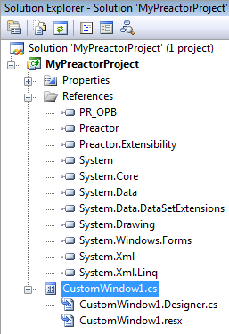
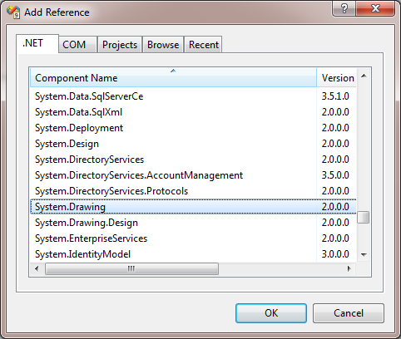
Custom Windows
Add the Template Item:
Add the .NET Reference:

Slide 136
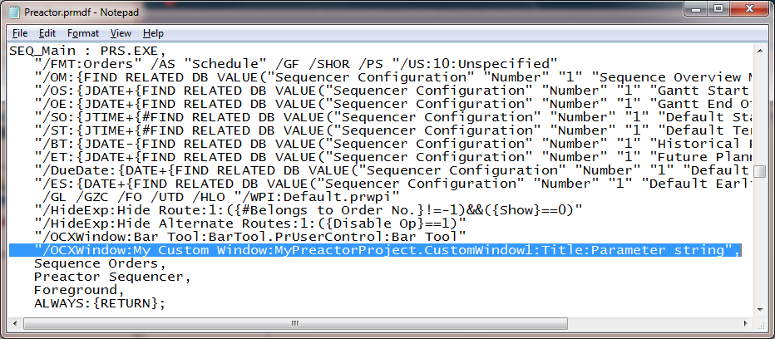
Custom Windows
Must be called from a tool button defined in the .prMdf file:
Project Name
Control Name
Window Title
String Parameter
(passed to OnOpen function)
Tool Name

Slide 137
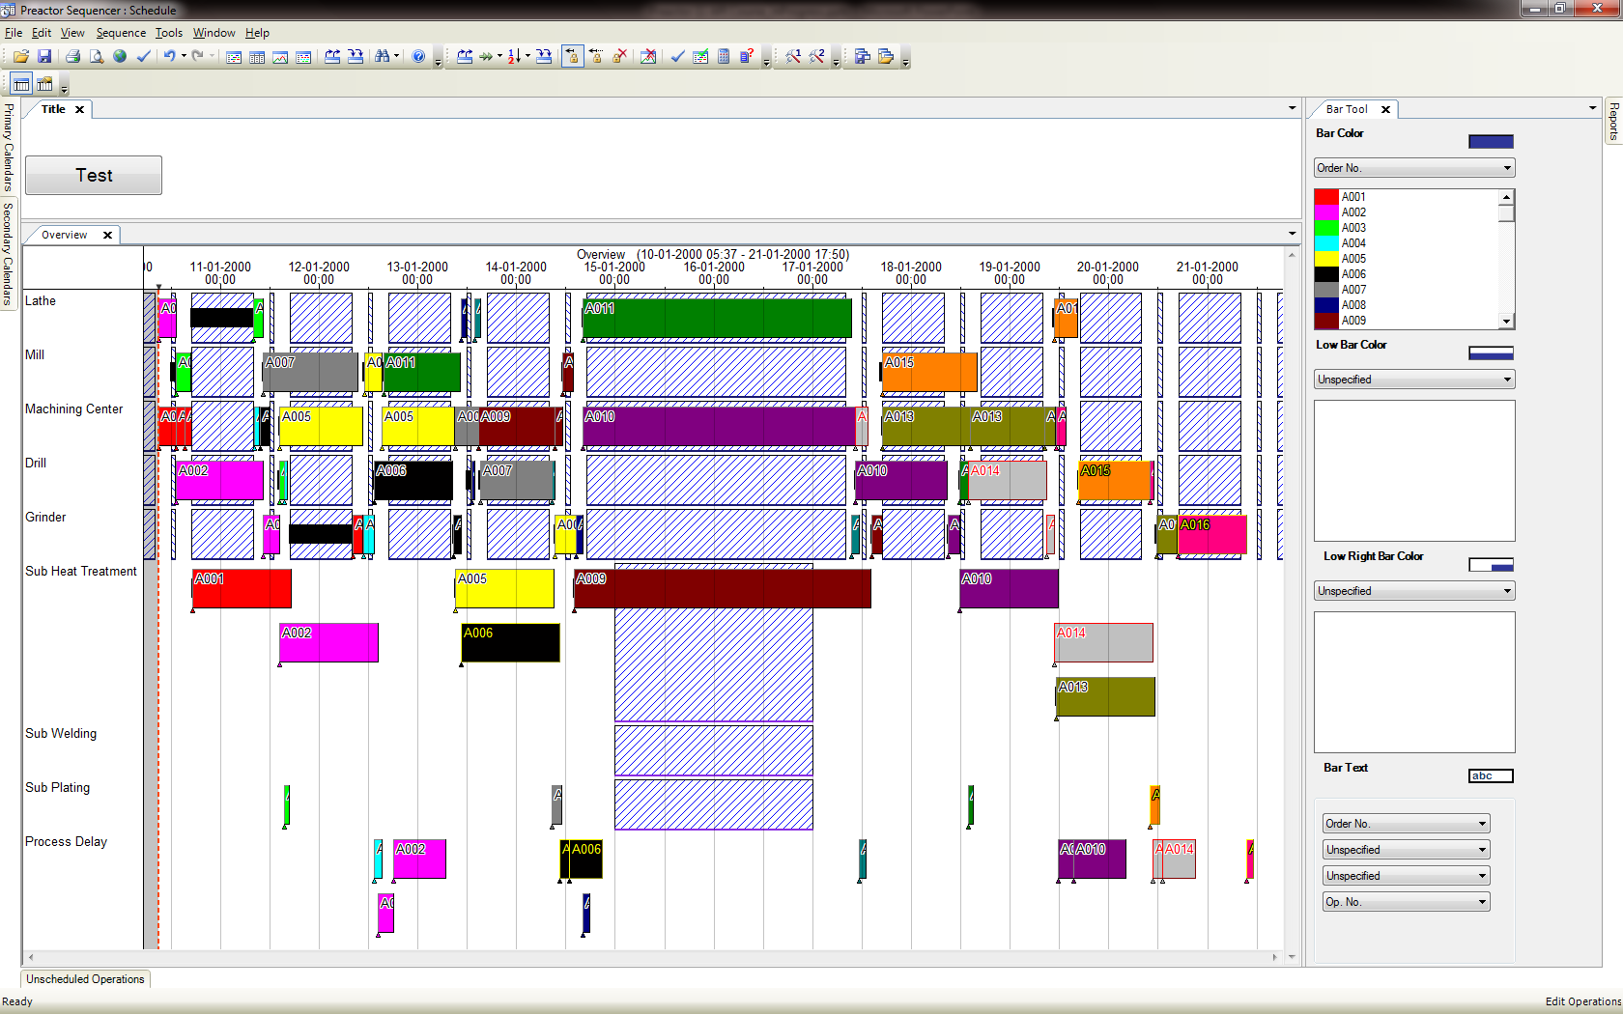
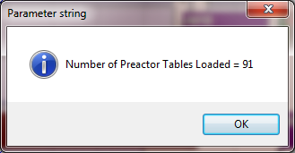
Custom Windows
Example of a simple custom window in Preactor:

Slide 138
Workshop 8 Implement a Custom Window in the Example Configuration

Slide 139
Workshop 8
Implement a Custom Window In the Configuration Provided.
Add a button to the form that displays ‘Hello World’ message box when the user clicks on.
Task Steps:
Add the Custom Window Template Item to your Project
Add a reference to System.Drawing
Using the ToolBox, draw a button on the form
Edit the On Click event code to display a message box
Edit the .PrMdf file
Add the /OCXWindow command line parameter to create the tool button.
Compile & test

Slide 140
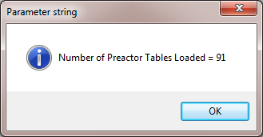
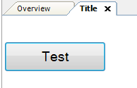
Workshop 8 - Extension
Demonstrate the use of the Preactor object in your message box and display a string parameter as the title:

Slide 141
Workshop 8
Hints
Define a global string parameter
In the OnOpen function copy the local parameter value into the global parameter
Display the Message box, for example (C#):
int TblCount = preactor.FormatCount;
MessageBox.Show(string.Format("Number Tables Loaded = {0}", TblCount),GlobalParameter,MessageBoxButtons.OK,MessageBoxIcon.Information);

Slide 142
Further Information
A Windows Form user control that can be displayed within the Preactor Sequencer
The Preactor API documentation is located here:
C:\Program Files\Preactor International\Preactor12.x\SDK
All resources used during this course can be copied from your training machine (e.g via USB) from the location:
Desktop\Training Files\API Course

Slide 143
Preactor API Training
Course Complete
Thank You For Attending

